Slide 1
EfficientNetV2: Smaller Models and Faster Training Mingxing Tan, Quoc V.Le Google Brain

Slide 2
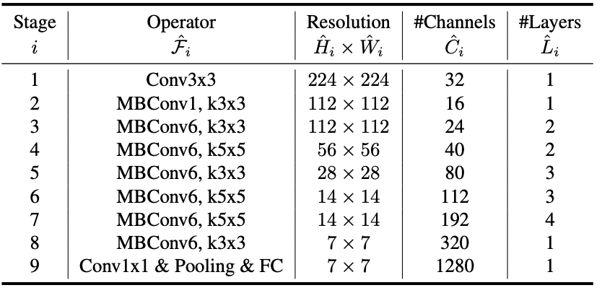
EfficientNetV1
Target: ${d=α}^{φ},w=β^{φ}, r=γ^{φ}, s.t. α∗β^{2}{∗γ}^{2}≈2$.
NAS: neural network research to find the optimal baseline
EfficientNetB0
Problems: 1. Depthwise conv is slow in early
2. Training large img size is slow
3. Equally scaling is sub-optimal

Slide 3
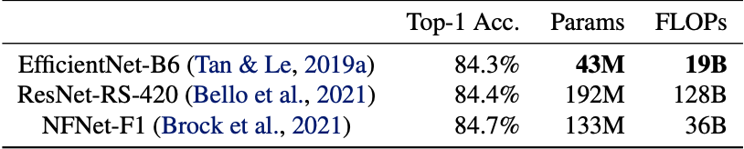
Related Work
Training vs Parameters.
Progress training: dynamic change training settings. Adjust regularization
Neural Architecture Search: optimize training and parameter efficiency.

Slide 4
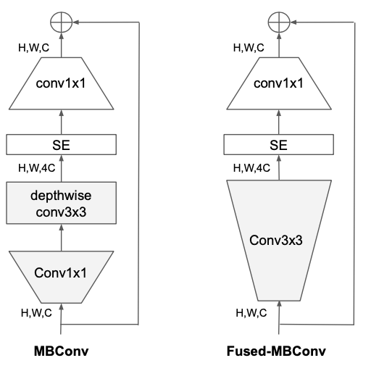
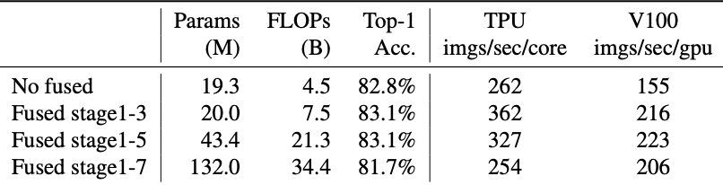




EfficientNetV2- pro.1
MBConv vs Fused-MBConv
Use Nas to search the best combination.
$$A∗S^{w}{∗P}^{v},where w=−0.07,v=−0.05$$
$A$ for accuracy
$S$ for step time
$P$ for step parameter size

Slide 5
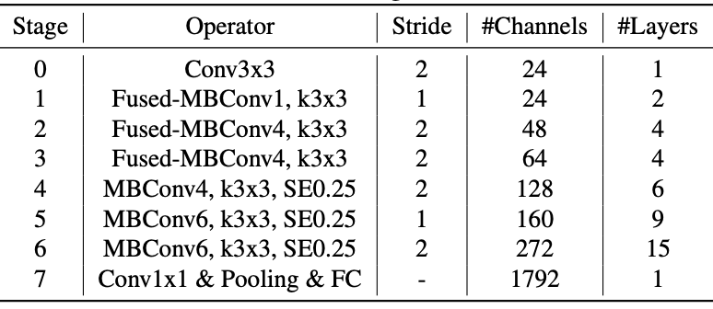
EfficientNetV2
Restrict the maximum img size to 480. (r.t Pro.2)
Gradually add more layers to later stages. (r.t Pro.3)

Slide 6
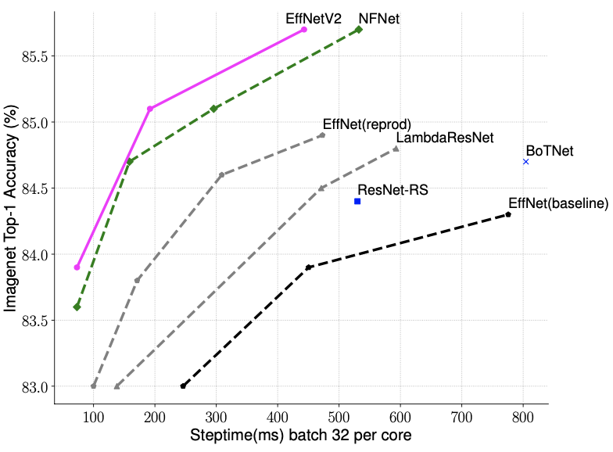
EfficientNetV2

Slide 7
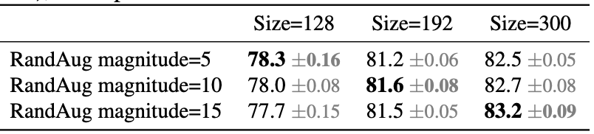
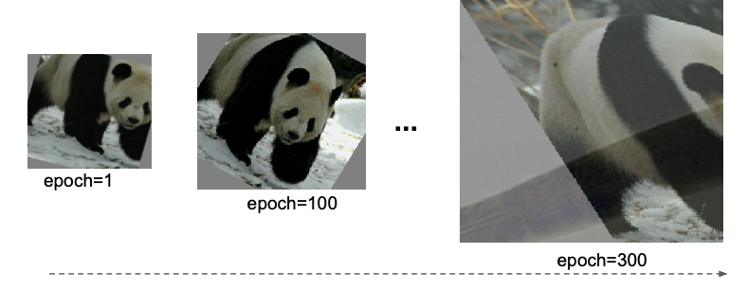
Progressive Learning
Hypothesize: unbalanced regularization.
Neural Architecture Search: optimize training and parameter efficiency.

Slide 8
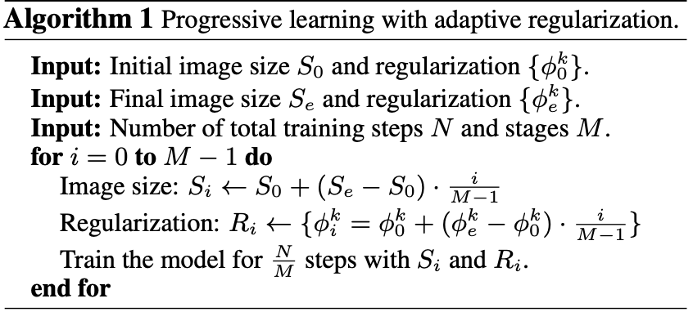
Progressive Learning
Dropout: adjust rate $γ$.
RandomAug: adjust magititude $ε$.
Mixup: ($x_{1},y_{1}$), ($x_{2},y_{2}$) $→\tilde{x}=λx_{1}+\left(1−λ\right)x_{2},$ $\tilde{y}=λy_{1}+(1−λ)y_{2}$, .

Slide 9
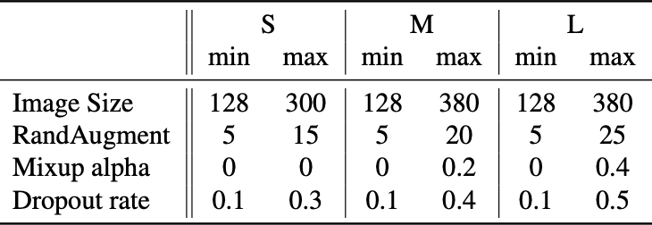
Result-ImageNet
EfficientNet-S/M/L is searched by NAS

Slide 10
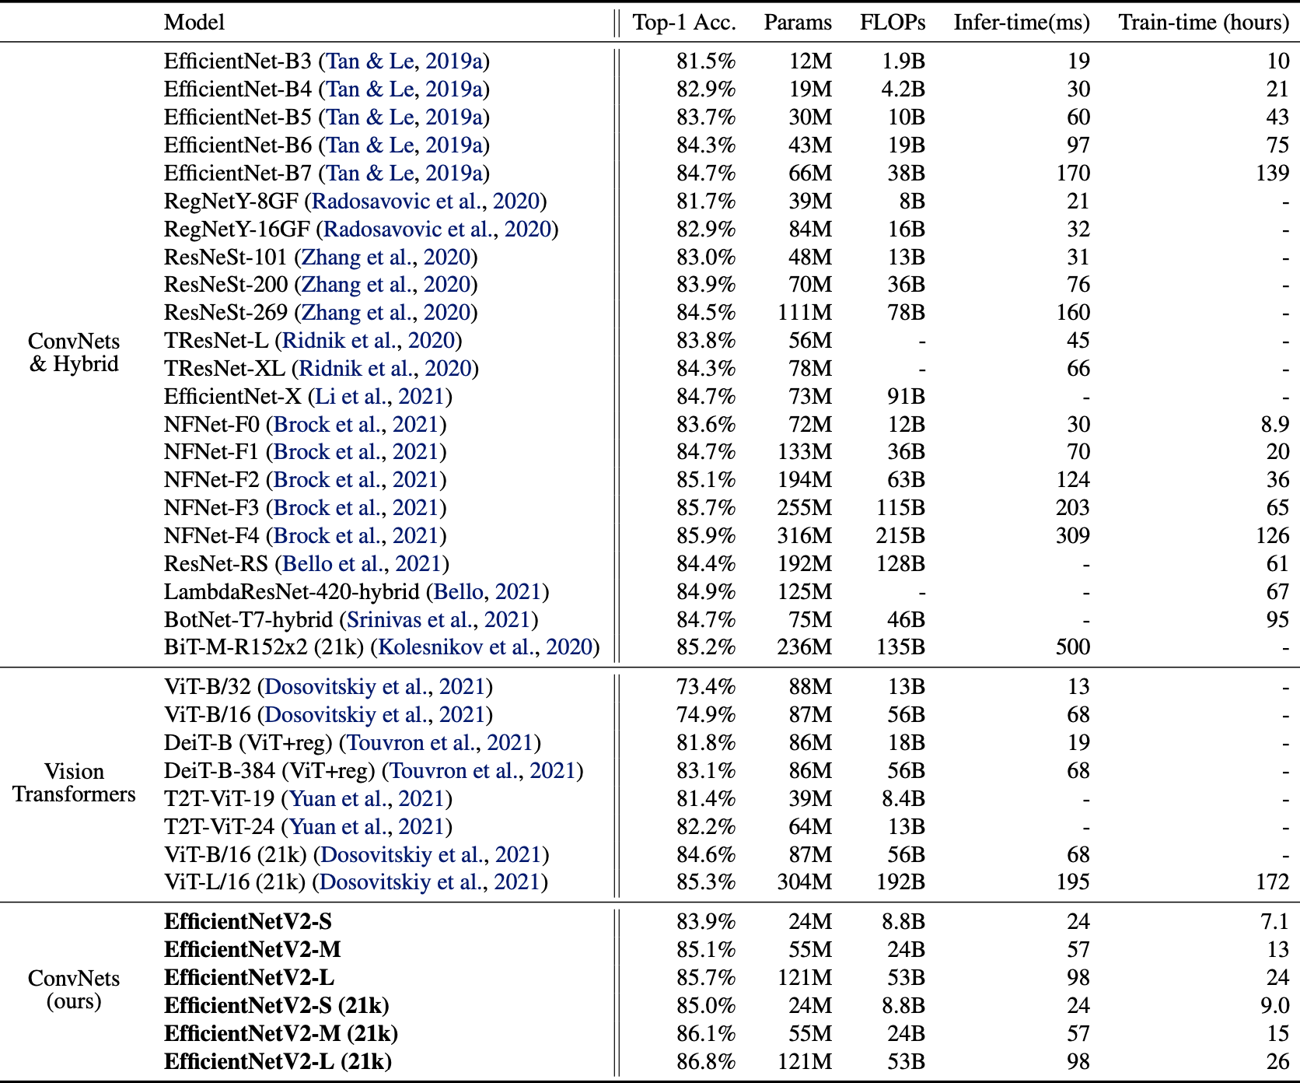

Slide 11
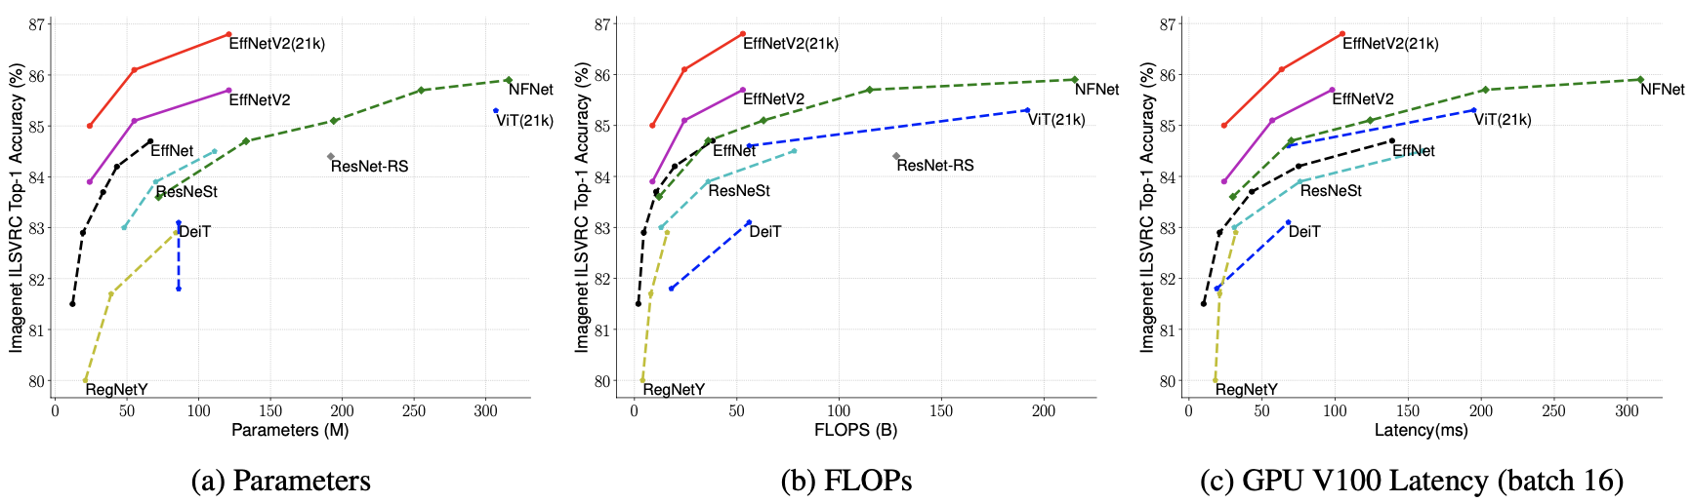
Result-ImageNet
EfficientNet-S/M/L has better params size bur runs 3x faster.
Scaling up data size is more effective than scaling model size.

Slide 12
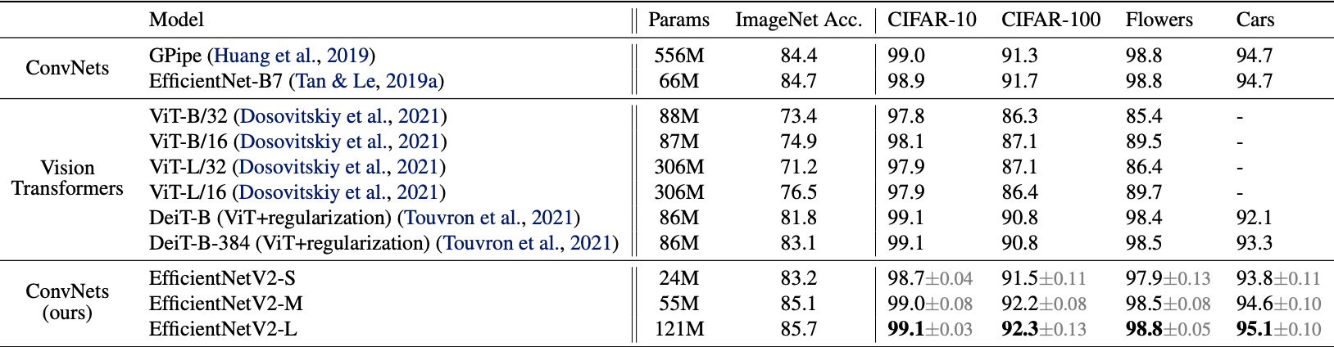
Result-Transfer
Pre-trained on ImageNet

Slide 13
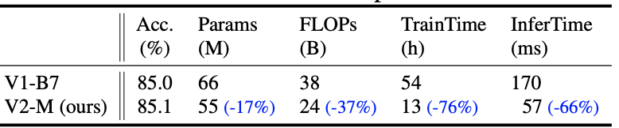
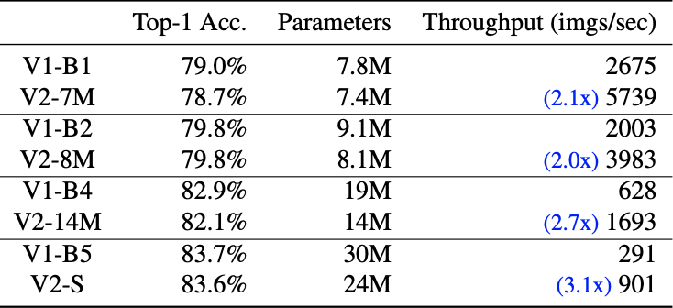
Result-Alation
Compare with EfficientNetV1.
Scaling down model size. Based on V2-S.

Slide 14
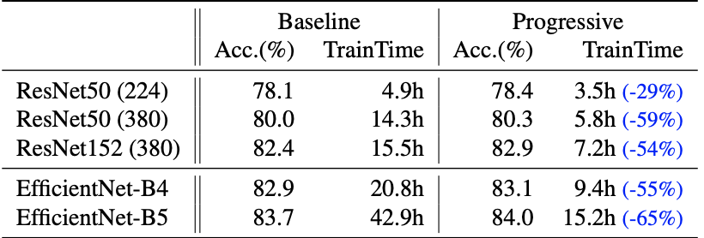
Result-Alation
Progress learning.
Same result but speed up by 2.2x.

Slide 15
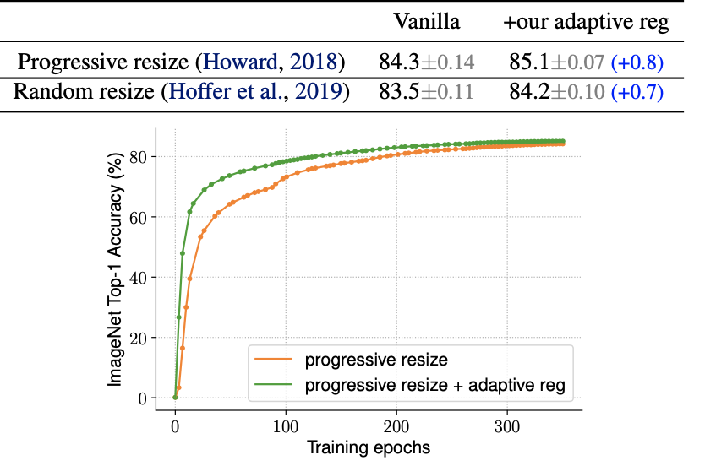
Result-Alation
Adaptive Regularization.

Slide 16
Conclusion
EfficientNetV2: faster and smaller.
Improved method with progressive learning.(Image size and regularization).
Params & Efficient in Nas.

Slide 17
Thank you (Q&A)
Notes:
RP Shortcomings：1.relative position has multi result. 2.CNN learn trivial features. 3. not whole picture.

